Slide 1


Confusion matrix:
Classification problem

Slide 2
What is confusion matrix?
It is a matrix of size 2×2 for binary classification with actual values on one axis and predicted on another.
Accuracy performance metrics can be decisive when dealing with imbalanced data.

Slide 3
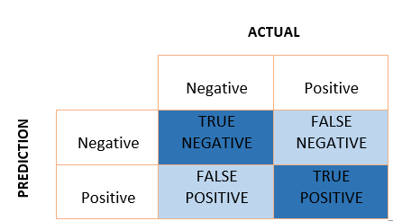
How confusion matrix look like?

Slide 4
Full form:
True Positive(TP): The model predicted ‘Positive’ and it’s actual class is ‘Positive’, which is ‘True’
False Positive(FP): The model predicted ‘Positive’ and it’s actual class is ‘Negative’, which is ‘False’
False Negative(FN): The model predicted ‘Negative’ and it’s actual class is ‘Positive’, which is ‘False’
True Negative(TN): The model predicted ‘Negative’ and it’s actual class is ‘Negative’, which is ‘True’

Slide 5
Let’s understand the confusing terms in the confusion matrix: true positive, true negative, false negative, and false positive with an example:
A machine learning model is trained to predict tumor in patients. The test dataset consists of 100 people.
True Positive (TP) — model correctly predicts the positive class (prediction and actual both are positive). In the above example, 10 people who have tumors are predicted positively by the model.
True Negative (TN) — model correctly predicts the negative class (prediction and actual both are negative). In the above example, 60 people who don’t have tumors are predicted negatively by the model.

Slide 6
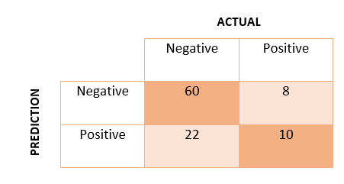

Slide 7
False Positive (FP) — model gives the wrong prediction of the negative class (predicted-positive, actual-negative). In the above example, 22 people are predicted as positive of having a tumor, although they don’t have a tumor. FP is also called a TYPE I error.
False Negative (FN) — model wrongly predicts the positive class (predicted-negative, actual-positive). In the above example, 8 people who have tumors are predicted as negative. FN is also called a TYPE II error.

Slide 8
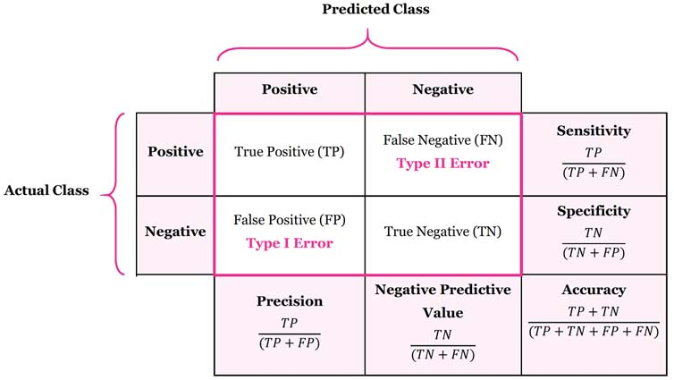
Some other terms:

Slide 9
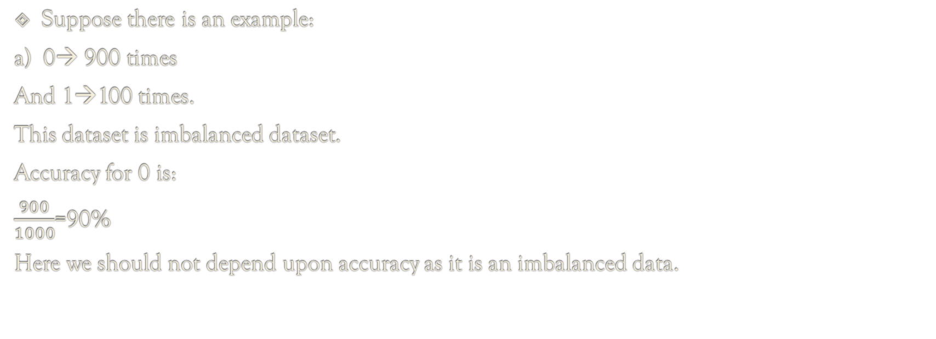
In case of biased dataset:
Suppose there is an example:
a) 0→ 900 times
And 1→100 times.
This dataset is imbalanced dataset.
Accuracy for 0 is:
$\frac{900}{1000}$=90%
Here we should not depend upon accuracy as it is an imbalanced data.

Slide 10
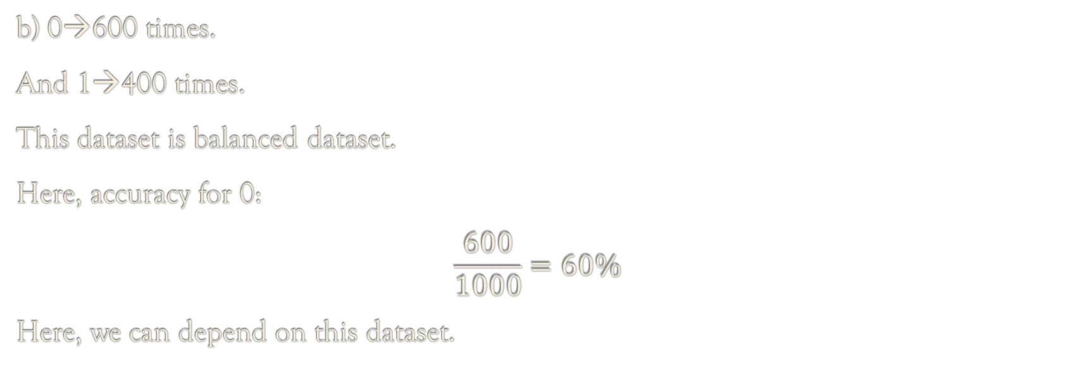
Another example:
b) 0→600 times.
And 1→400 times.
This dataset is balanced dataset.
Here, accuracy for 0:
$$\frac{600}{1000}=60\%$$
Here, we can depend on this dataset.

Slide 11


But there are some solutions:
Precision: Out of all the positive predicted, what percentage is truly positive. Aim is to reduce FP.
Recall: Out of the total positive, what percentage are predicted positive(actually positive). Aim is to reduce FN.

Slide 12
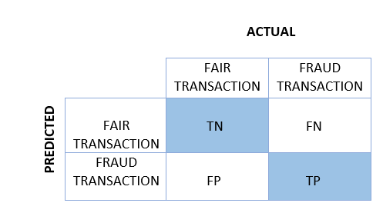
Eg: Credit card fraud detection
We do not want to miss any fraud transactions. Therefore, we want False-Negative to be as low as possible. In these situations, we can compromise with the low precision, but recall should be high. Similarly, in the medical application, we don’t want to miss any patient. Therefore we focus on having a high recall.

Slide 13
So far, we have discussed when the recall is important than precision. But, when is the precision more important than recall?

Slide 14
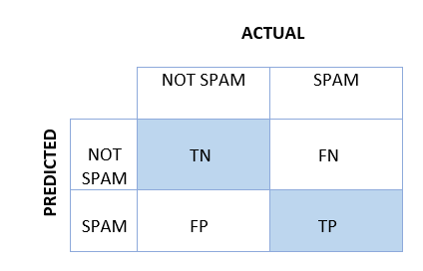
Eg: Spam detection
In the detection of spam mail, it is okay if any spam mail remains undetected (false negative), but what if we miss any critical mail because it is classified as spam (false positive). In this situation, False Positive should be as low as possible. Here, precision is more vital as compared to recall.

Slide 15
Is tomorrow the stock market going to crash?
Should we focus on precision or recall?

Slide 16
Solution:
The answer will be based on whose point of view?
Industry(Bad for companies)
Or Buyer(Can be good for people as they can sell it)

Slide 17
For buyer and Companies:
Buyer: Here we can use Recall as here we have to low the value of FN.
Company: Here we can use Precision, FP value must be less.

Slide 18
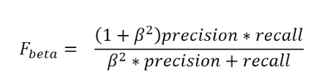
F-beta:
Whenever FP and FN both are important: beta=1
Also called harmonic mean/F1-score.

Slide 19

F1 Score:
F1 Score: It is the harmonic mean of precision and recall. It takes both false positive and false negatives into account. Therefore, it performs well on an imbalanced dataset.
F1 score gives the same weightage to recall and precision.

Slide 20

Another case:
When FP is more important than FN: beta=0.5

Slide 21

Another case:
When your FN is more important then FP: beta=2

